Slide 1
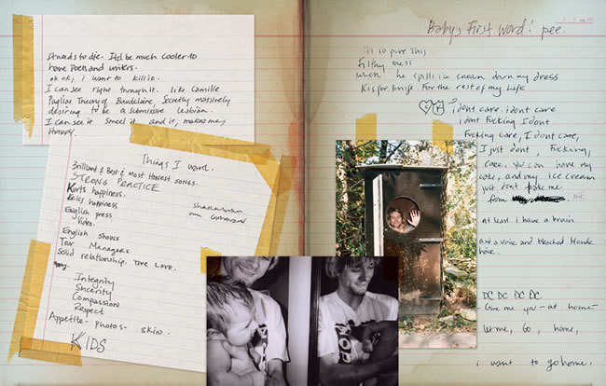
Interactive Narrative and Avant-Garde Game Design

Slide 2
Required Readings:
Flanagan, Mary. (Ch. 4 Language Games). Critical Play: Radical Game Design. MIT Press, 2009.
Gillian, Whitlock, and Poletti Anna. "Self-regarding Art." Biography. 31.1 (2008).
Friedhoff, Jane. “Untangling Twine: A Platform Study”. Proceedings of DiGRA 2013: DeFragging Game Studies. 2013.

Slide 3

Class Objectives
Notes:
The readings tie to the class objectives.

Slide 4
Class Objectives
1. Discuss and analyze the aesthetic, conceptual, and cultural potential of experimental game design
Notes:
The first two readings focus on theory of the avant-garde.

Slide 5
Class Objectives
1. Discuss and analyze the aesthetic, conceptual, and cultural potential of experimental game design
2. Identify the formal and political strategies of some Avant-Garde art

Slide 6
Class Objectives
1. Discuss and analyze the aesthetic, conceptual, and cultural potential of experimental game design
2. Identify the formal and political strategies of some Avant-Garde art
3. Consider the game diary as an experimental game genre (mapping the Avant-Garde)
Notes:
The third reading zeroes in on a specific art/media genre called Autographics—visual/graphic forms of autobiographical narrative and memoir, self-portrait, avatar construction, and so forth…

Slide 7
Class Objectives
1. Discuss and analyze the aesthetic, conceptual, and cultural potential of experimental game design
2. Identify the formal and political strategies of some Avant-Garde art
4. Launch a creative experimental practice using the Twine platform
3. Consider the game diary as an experimental game genre (mapping the Avant-Garde)
Notes:
With the last reading, we are picking a digital platform for authoring the autobiographical or personal game, which is Twine.

Slide 8
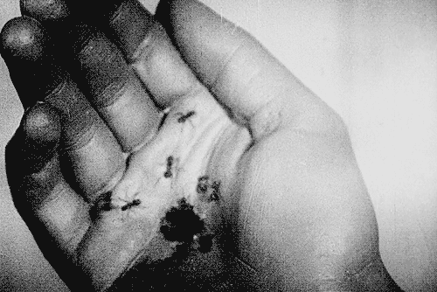
What is the Avant-Garde?
Brainstorming:
Un Chien Andalou (Luis Buñuel‎, 1929)
Notes:
It was a transgressive movement. But transgressing what?

Slide 9
What is the Avant-Garde?
French for vanguard
Defines the progressive artistic movements of the 20th century (i.e., Modernism, Expressionism, Cubism, Dada, Surrealism, Fluxus, Situationism, etc.)

Slide 10
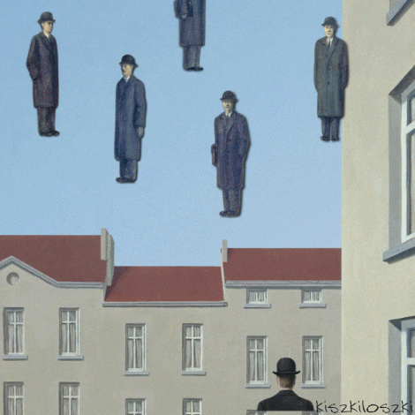
What is the Avant-Garde?
Art Death GIF by Kiszkiloszki
A set of formal and political strategies used by Avant-Garde artists

Slide 11
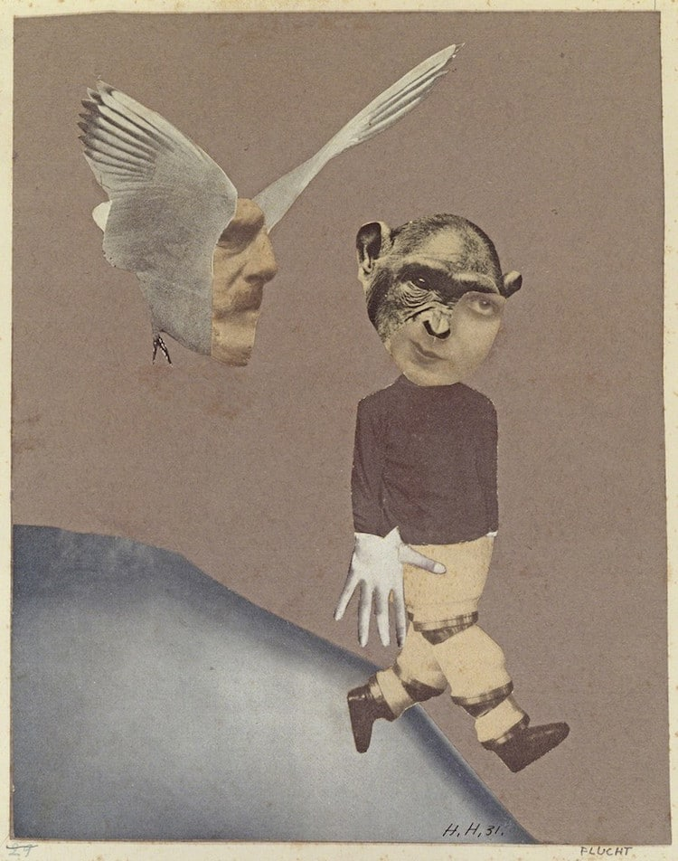
Formal strategies of the Avant-Garde
Collage and Assemblage
Flight (Hannah Höch, 1931)
Source: https://mymodernmet.com/collage-art-collage/
Notes:
Cut and paste motif, automatic approach to painting, assemblages made of photographs, illustrations, colored paper, and paint.
Relationship to cubism.

Slide 12
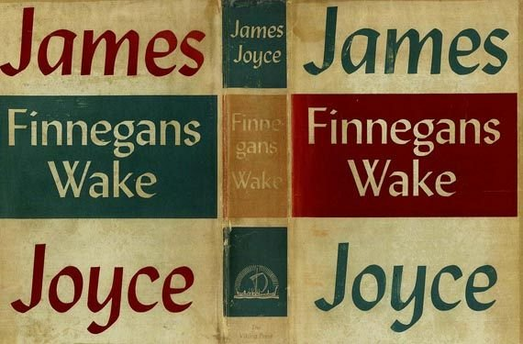
Formal strategies of the Avant-Garde
Defamiliarization and estrangement
“Make the ordinary strange.”
Viktor Shklovsky, 1928
Notes:
Shklovsky was a Russian Formalist who was talking about language here – this idea of using various devices such as sound, imagery, rhythm, syntax, metre, rhyme, narrative
techniques…in order to ‘‘defamiliarize”. What was specific to literary language, what distinguished it from other forms of discourse, was that it ‘deformed’ ordinary language in various ways (Terry Eagleton p. 3).
The Russian Formalist Viktor Shklovsky argued for art as making strange of the world. Art makes strange the normal order of things, defamiliarizes reality and nature. It is a way of preventing habitual or automatic readings. It jumpstarts the imagination.

Slide 13
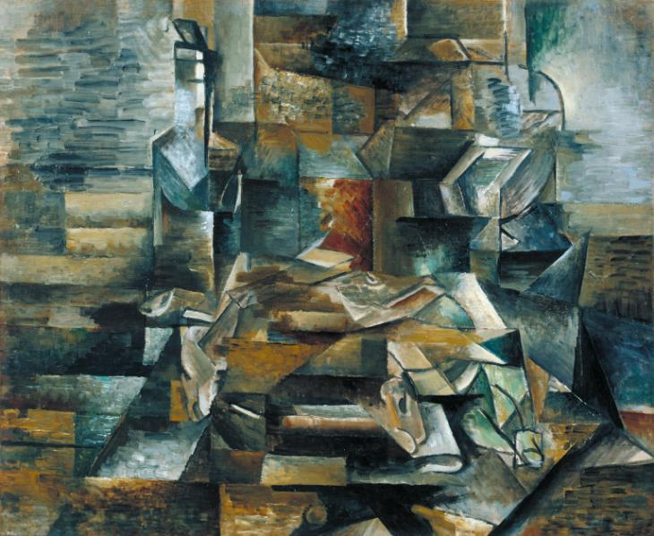
Formal strategies of the Avant-Garde
Abstraction (non-representationalism)
Bottle and Fishes (Georges Braque, c. 1910–12)
Notes:
Abstraction and non-representationalism was threatening to the establishment –reaction against naturalism.
Cubism defamiliarized common naturalistic painting techniques such as linear perspective and the illusion of depth and perspective on a flat surface, modelling, foreshortening, chiaroscuro.
Abstraction was sometimes were used as a way to glorify technology and machines (technological determinism). The geometric aesthetic and stark formalism of some abstract art invoked the mathematical arts and engineering.

Slide 14
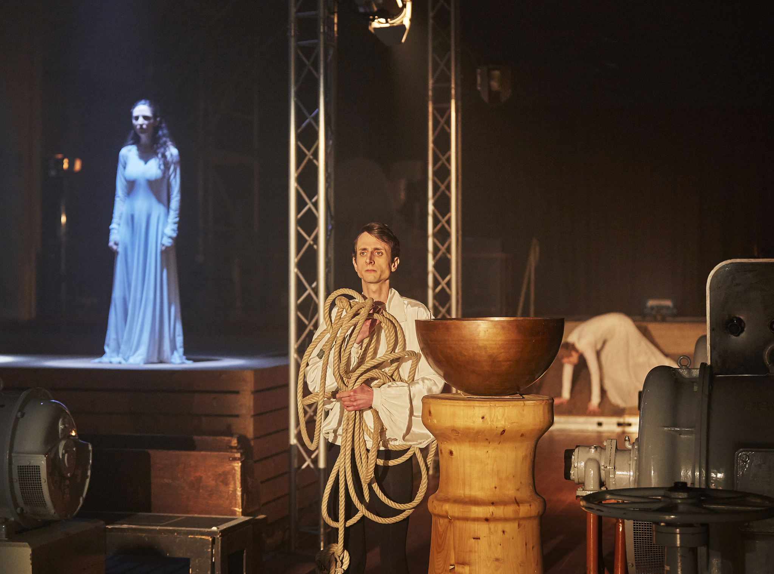
Formal strategies of the Avant-Garde
Self-reflexivity (i.e., Brechtian theatre)
Image source: https://e-cibs.org/issue-1-2018/
Notes:
Alienation:
This technique reveals the apparatus behind the illusion of theatre, making transparent the inner workings of theatre
The regular goal is to suspend belief in the audience – keep up the illusion of theatre as mimicking reality
Distancing tool to disengage viewer from being immersed in the world presented to us
Half-curtain (leaving curtain open so that audience could see scene/furniture being re-arranged, etc.)
Breaking fourth wall
The work speaks about its own artistic conventions and assumptions. Self-reflexivity is the text making strange its own formal devices.
This strategy presents a complication for games because the assumption is that games are immersive.

Slide 15
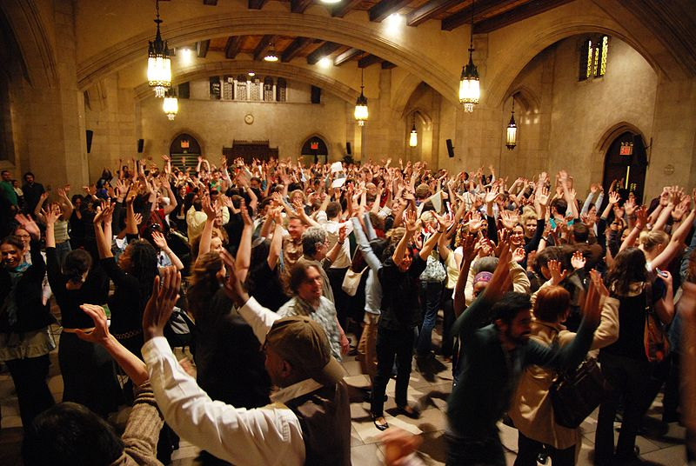
Formal strategies of the Avant-Garde
Co-authorship (performer-audience interaction)
Augusto Boal’s Theatre of the Oppressed (participatory theatre)
Notes:
Some of these strategies are natural to games and interactive fiction – this idea of co-authoring a narrative in IF is called distributed authorship
Distribution of authorship by allowing players to create lists, inventories, diagrams, maps, notes, etc. (Brian Shrank) p. 138
FLUXUS was a collective movement championing anti-individualism

Slide 16
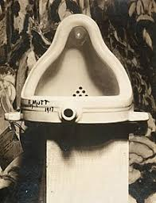
Political strategies of the Avant-Garde
Rebelling against dominant culture (role of provocateur)
Fountain
(Marcel Duchamp, 1917)

Slide 17
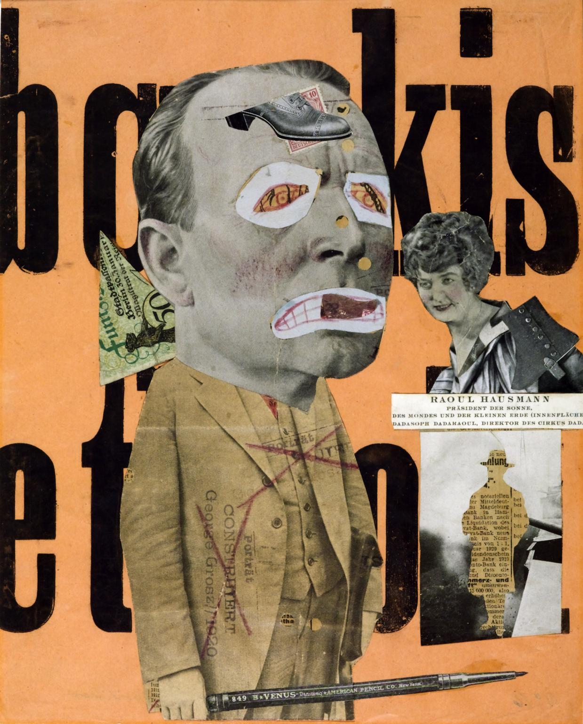
Political strategies of the Avant-Garde
Placed high value on experimentation (play)/ privileged artistic process over product
Challenged aesthetic/institutional art norms
Anti-commercial; anti-capitalist; socially transformative objectives
The Art Critic (Raoul Hausmann, 1919–20) Tate Gallery
Notes:
Avant-garde artists collapsed boundaries between high and low culture -what does that mean?
The elitist distinction between ‘high culture’ and ‘low culture’ refers to institutional norms and cultural regimes governing the production of creative works of art and poetry—the subordination of some forms over others. It is a hierarchy of art based on an institutional classification of quality.
Witness the moral panic that cinema engendered in its first decades branding it a lowbrow cultural form and undermining its seriousness as an art form.

Slide 18
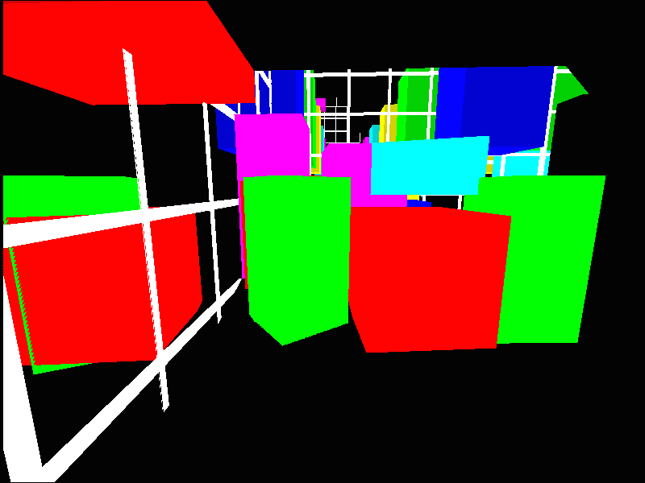
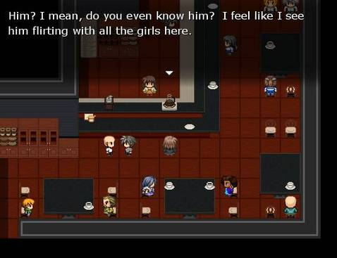
How do Avant-Garde’s strategies map to games?
Slipgate level in Untitled Game (Jodi)
Mainichi (Mattie Brice)
Notes:
A lot of productive tensions between avant-garde art and games, both mainstream and non-mainstream games

Slide 19

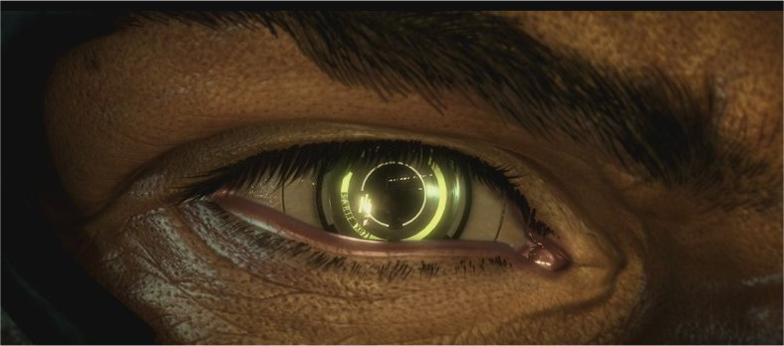
AAA games: combat-centric (FPS), reward-focused, win/lose, trope characters and stories
Mainstream games

Slide 20
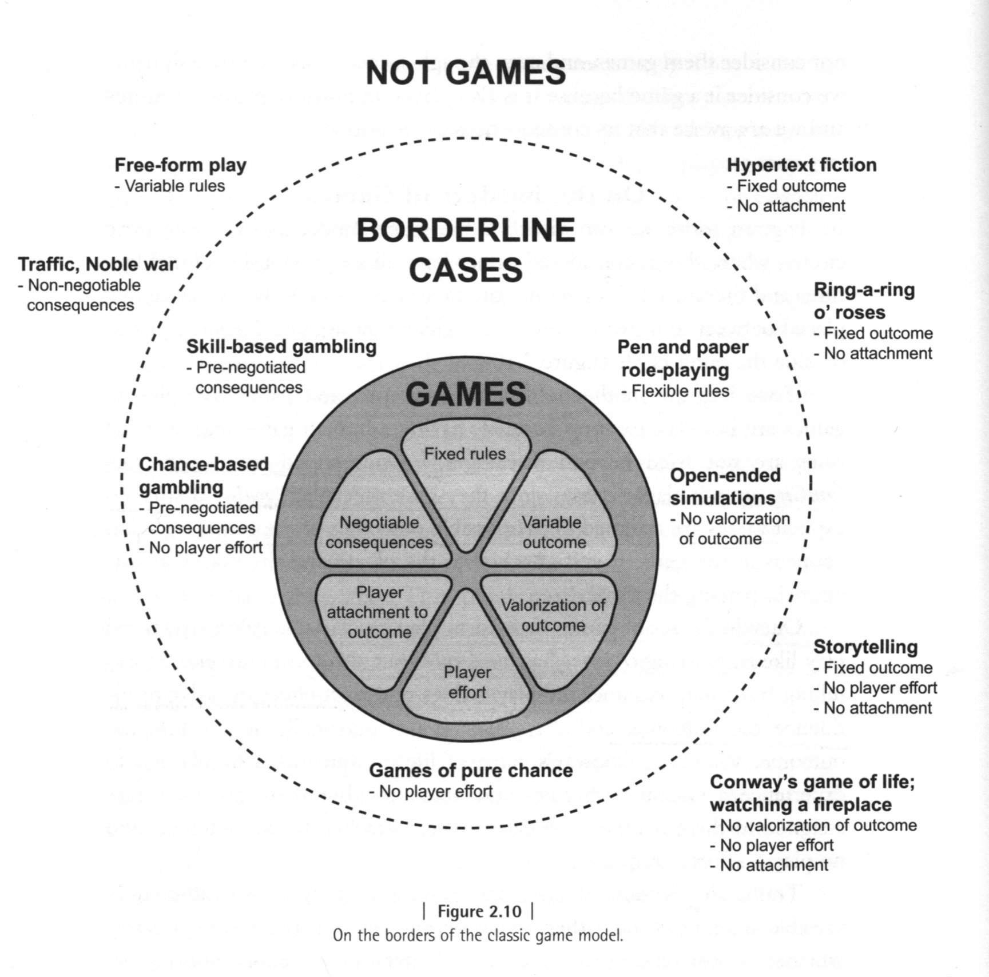
Jesper Juul’s (2011)
Classic Game Model

Slide 21
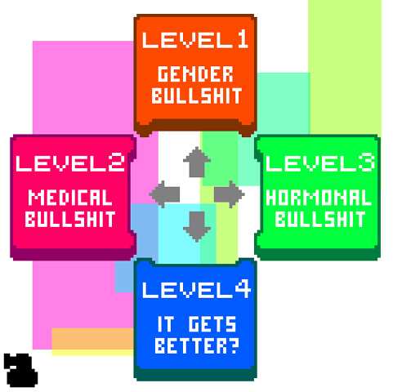
Contemporary Avant-Garde Games
“Put weird shit into your game.”
Anna Anthropy, 2012
Dys4ia (2012)
Notes:
Anthropy is not really giving away any concrete methods for what this means in this statement. What do you think this could mean in a game?

Slide 22
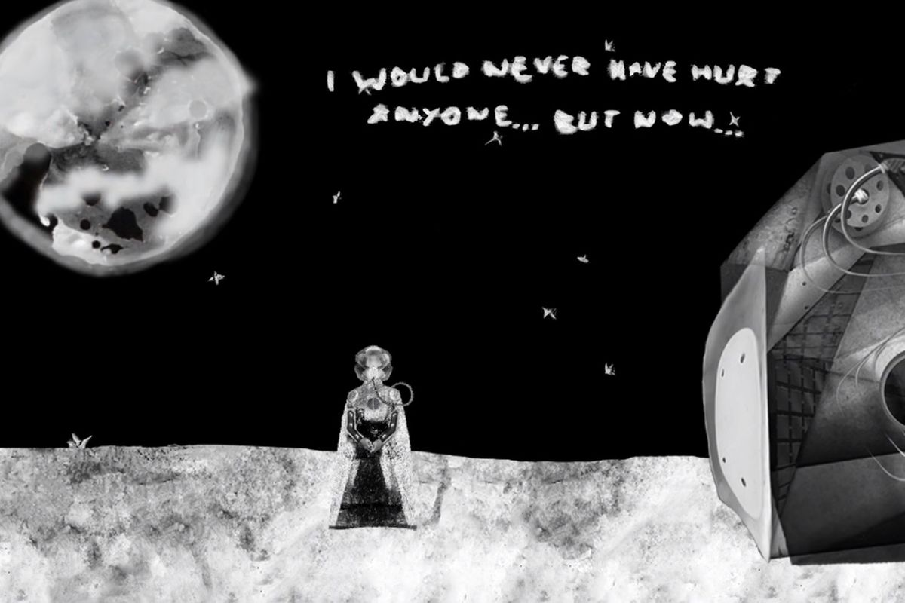
Contemporary Avant-Garde Games
Ritual of the Moon (Kara Stone, 2019)
Source: https://www.polygon.com/2018/5/9/17329332/ritual-of-the-moon-mental-health-games-art-student-ucsc
Notes:
Anthropy is not really giving away any concrete methods for what this means in this statement. What do you think this could mean in a game?

Slide 23
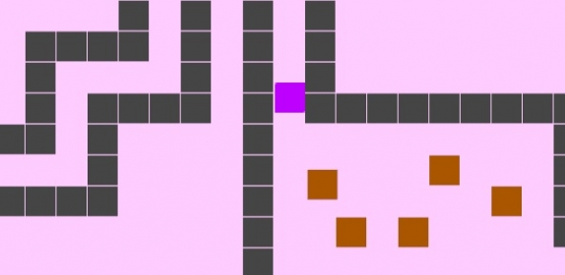
Contemporary Avant-Garde Games
Lim (Merritt Kopas, 2012)

Slide 24
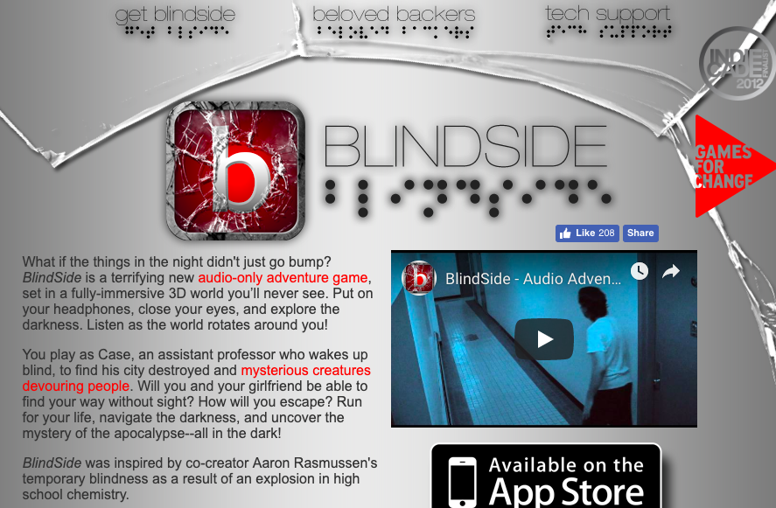
Contemporary Avant-Garde Games
Experimenting with games visually, textually, acoustically, procedurally, haptically, and algorithmically—
Notes:
What is the purpose of experimentation? No right or wrong answer.
I usually like to tie experimentation to some kind of higher purpose – conveying meaningful stories or experiences through games.

Slide 25
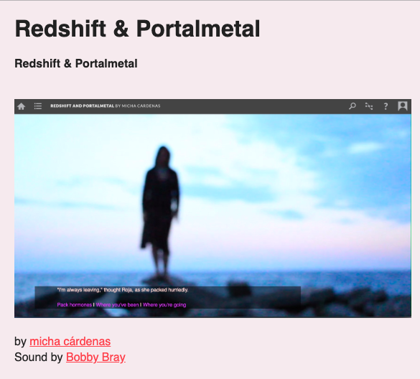
Contemporary Avant-Garde Games
Experimenting with games visually, textually, acoustically, procedurally, haptically, and algorithmically—for critical engagement with the world
Notes:
I usually like to tie experimentation to some kind of higher purpose – maybe conveying meaningful stories or experiences through games is an avant-garde strategy?
Games have the potential to build empathy, open dialogue, bring people together… they can be both personally and socially-transformative, they can galvanize a critical engagement with the world.
Redshift & Portalmetal asks: as climate change forces us to travel to the stars and build new homes and families, how do we build on this land, where we are settlers, while working to undo colonization? The story uses space travel as a lens through which to understand the experience of migration and settlement for a trans woman of color.

Slide 26
Mary Flanagan (2009) offers a theory of avant-garde games:
“Games designed for artistic, political, and social critique or intervention, in order to propose ways of understanding larger cultural issues as well as the games themselves.” (p. 2)
“Games as systems for critical thinking” (p. 93)

Slide 27

What is a diary?
Notes:
To unpack the properties is useful because we often take those ontological dimensions for granted

Slide 28
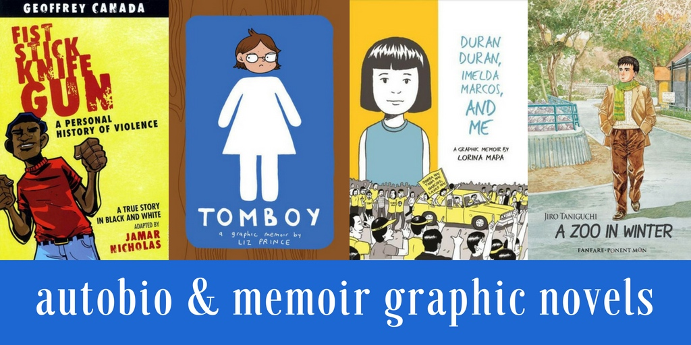
“Self-Regarding Art” (Whitlock and Poletti, 2008)
“The textual cultures of autographics—social networking services, zines, comics, and graffiti—invoke the specter of juvenilia”.
Adolescent experimentation with self-image (juvenilia) is a narrative strategy of autographics

Slide 29
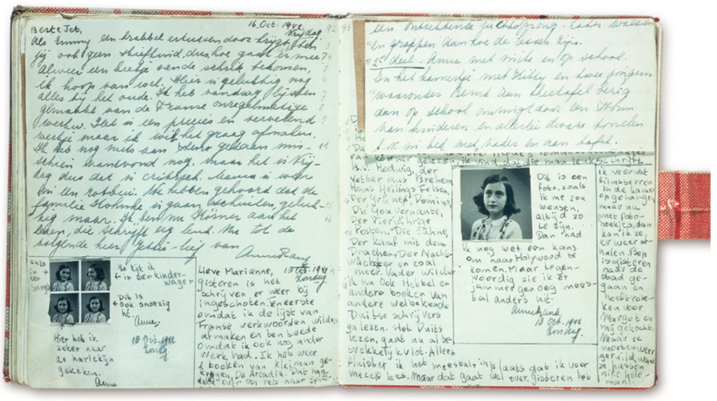
The diary of Anne Frank (published 1952)
Source: https://www.smithsonianmag.com/history/how-anne-franks-diary-changed-the-world-180957215/

Slide 30
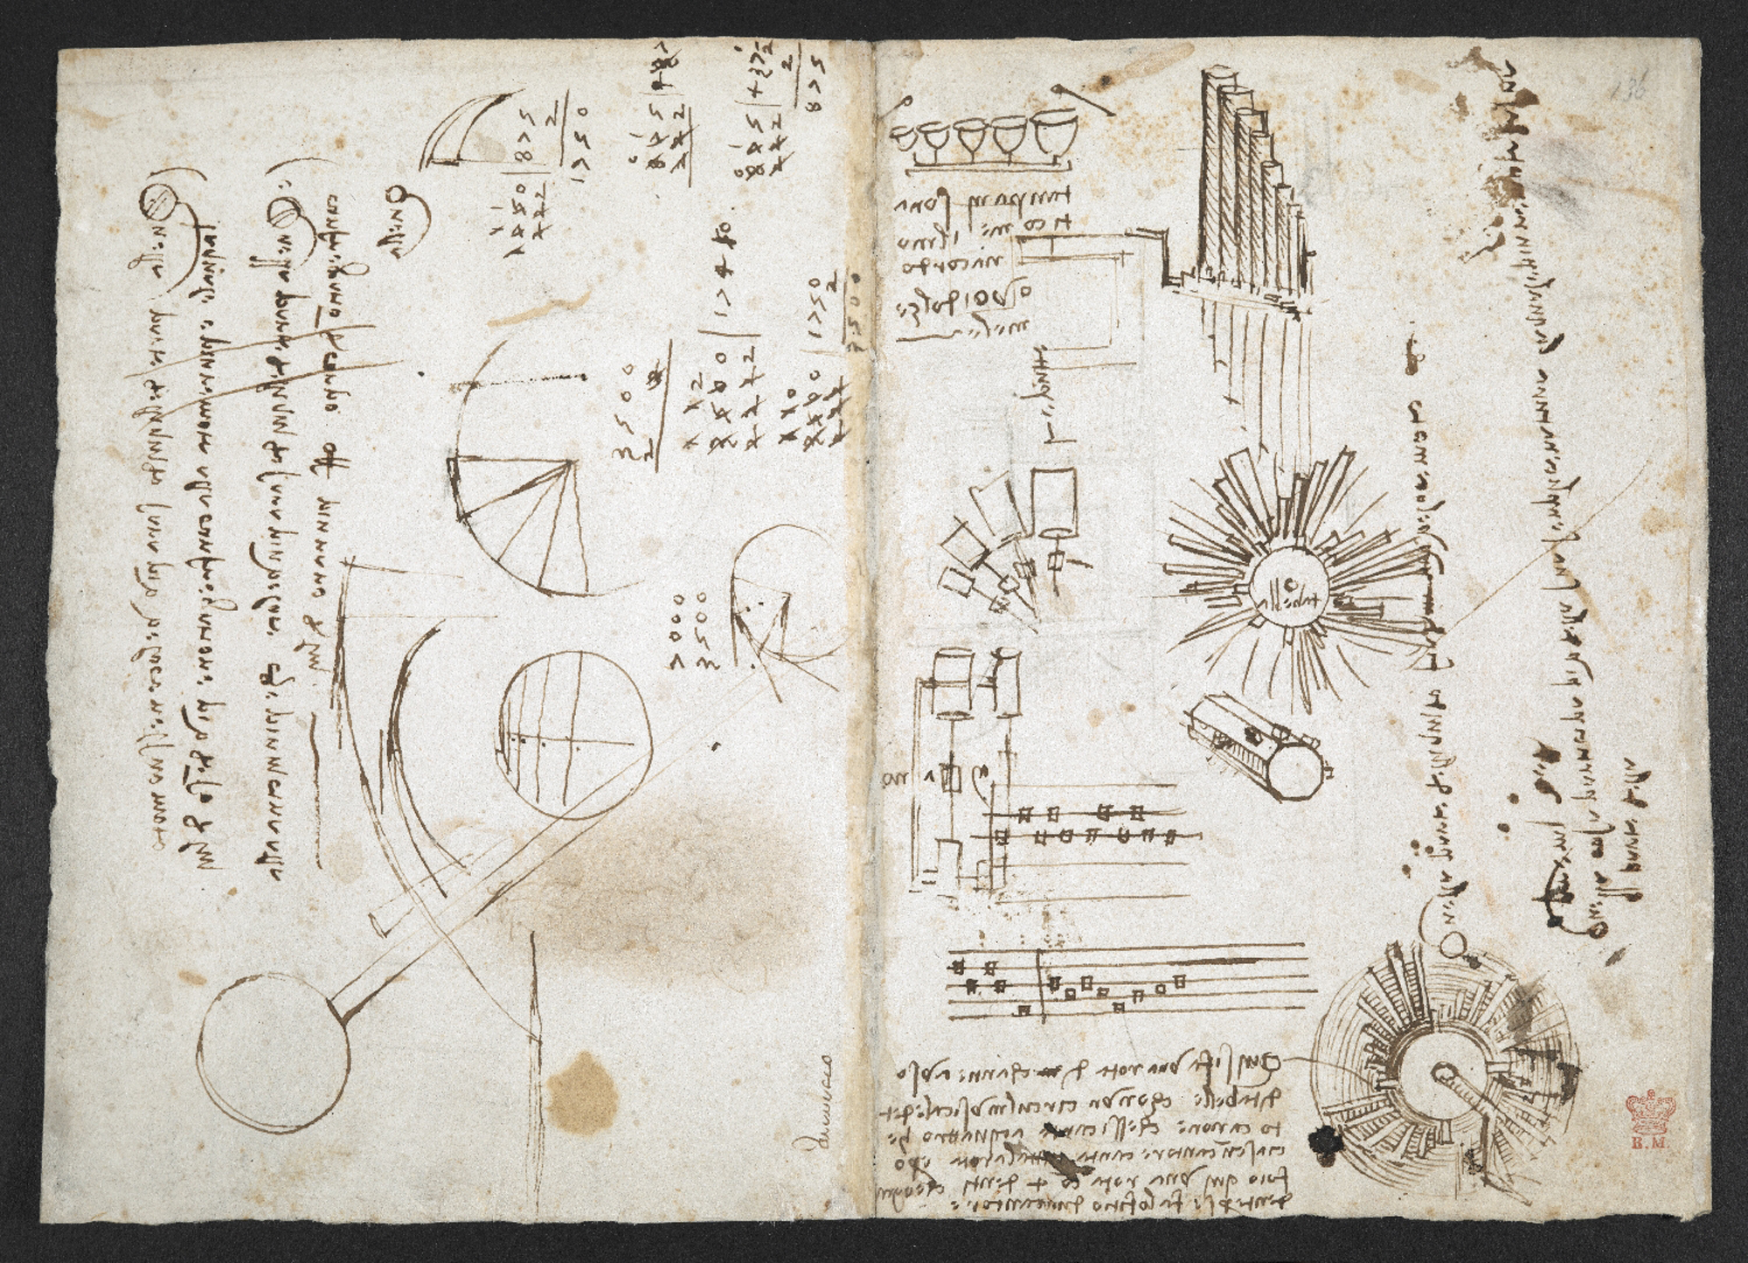
The diary of Leonardo da Vinci (1452 - 1519)
Source: https://www.bl.uk/collection-items/leonardo-da-vinci-notebook

Slide 31
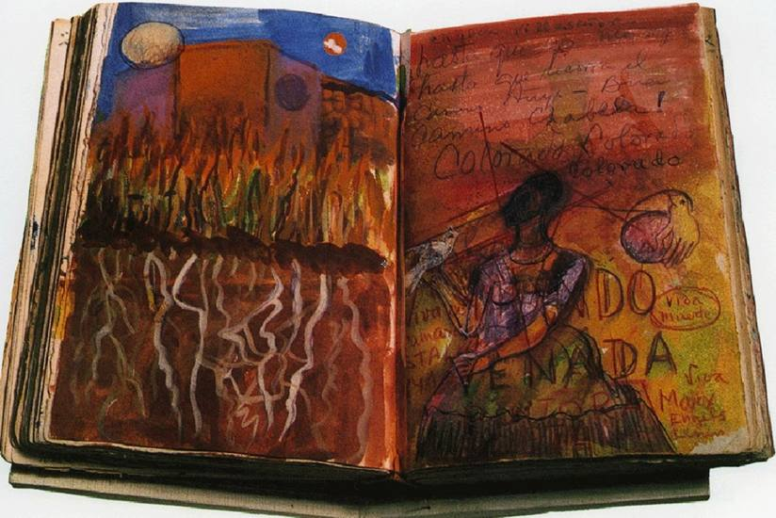
The diary of Frida Kahlo (1907-1954)

Slide 32
“Dirty Blonde: The Diaries of Courtney Love” (2006)
Notes:
Inventories, maps, notes, diagrams – distributed authorship

Slide 33
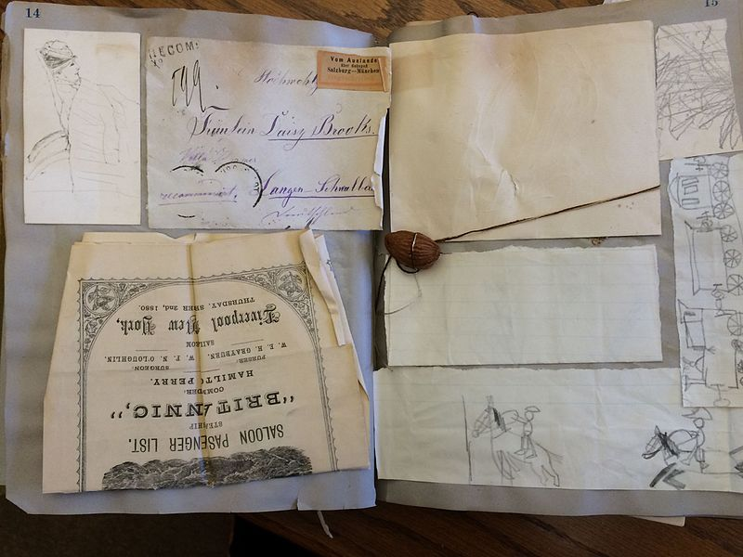
The personal scrapbook of Hannah de Rothschild Scharps, Smith College class of 1906, Smith College Archives, Sophia Smith Collection (Wikimedia Commons).
Notes:
Inventories, maps, notes, diagrams – distributed authorship

Slide 34
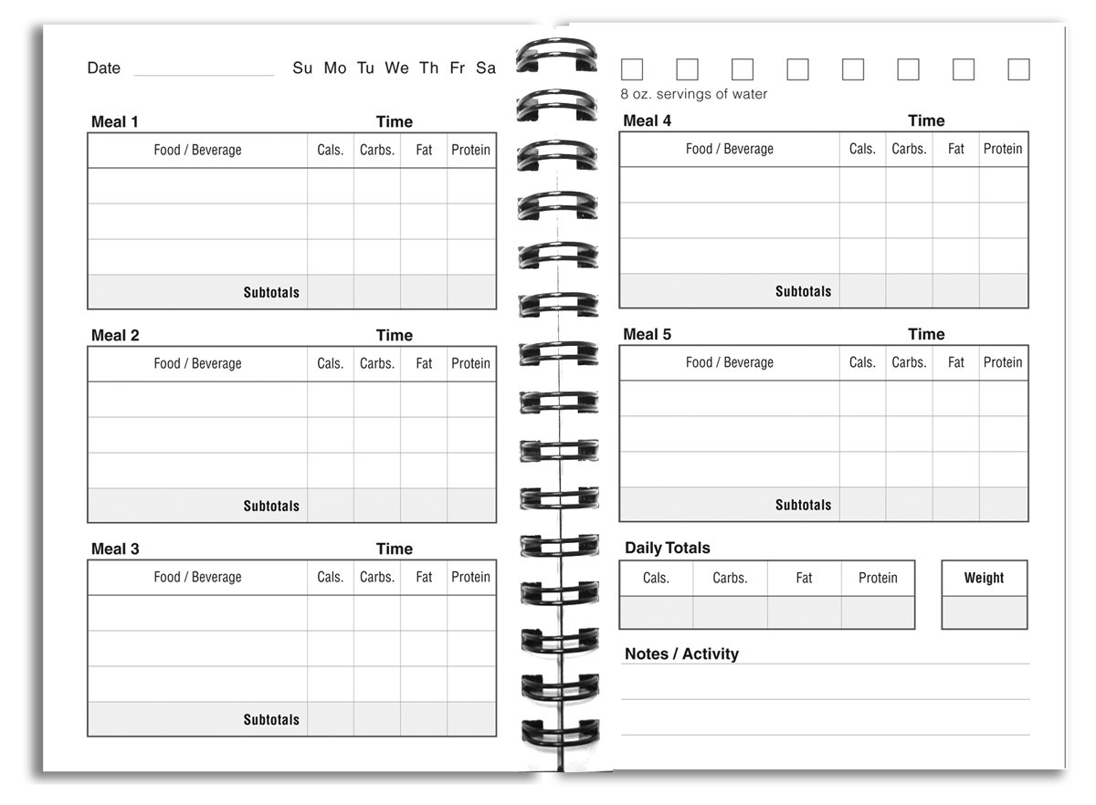
Food Diary (a.k.a. The Quantified Self)
Notes:
Inventories, maps, notes, diagrams – distributed authorship

Slide 35
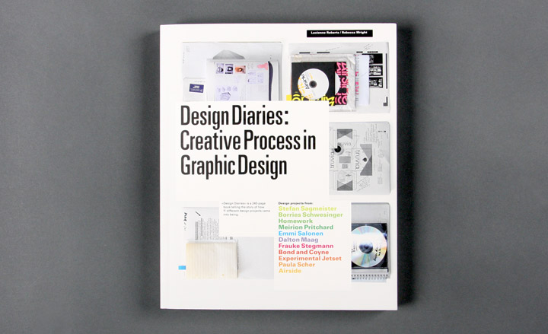
Design Diary: documenting the design process
Notes:
Inventories, maps, notes, diagrams – distributed authorship

Slide 36
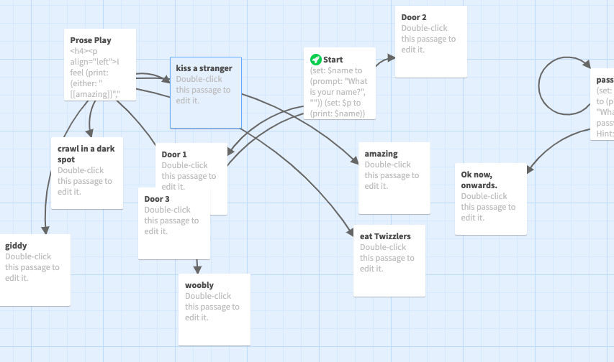
The Twine Revolution
“Twine is a platform that supports the creation of interactive stories that have branching narratives and variable states.” (Friedoff, 2013)
Notes:
Twine has been harnessed by largely marginalized communities—women, LGBTQ designers, and artists seeking to make hyper-personal games about their lived experiences.

Slide 37
Twine genres
1. Choose-your-own-adventure games
2. E-poetry
3. Autobiographical and personal games
4. Chatbots (i.e., computer therapist Eliza)
5. Web documentary (iDoc)
6. “The Ludic Diary” or “Interactive Scrapbook”

Slide 38
3 Design Stages:
1. Ideation and Conceptualization
Mapping Avant-Garde strategies to game design
2. Story/Concept Design in Twine
The Game Diary: mapping narrative (organizational) structure to Twine format
3. Implementation
Implementing images/sound (HTML)
Variables, conditionals (JavaScript-based)
Visual layout (CSS)
Data maps (JavaScript-based)
Notes:
I am dealing with first point only

Slide 39
Stage 1: Mapping the Avant-Garde
Pick 2 formal strategies and 1 political strategy of the Avant-Garde and think about how they will render in your Twine game:
Formal Strategies:
Abstraction
Defamiliarization
Self-reflexivity
Co-authorship
Collage/Assemblage
Etc.
Political Strategies:
Challenge aesthetic/narrative norms of mainstream games
Provoke
Etc.
Notes:
Going from IMAGE TO TEXT is a textualization (instead of visualization)
GLITCHING can be used as a self-reflexive technique to disrupt game/frustrate immersion/illusion of gameworld
Co-authorship – narrative maps, inventories, diagrams, etc.

Slide 40
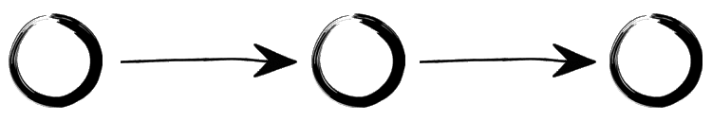
Stage 2: Mapping Narrative Structure
1. Linear Narrative
This type of narrative has a linear story trajectory and fixed outcome.
Diagrams courtesy of: https://directorsnotes.com/2016/08/08/interactive-documentary-guide/

Slide 41
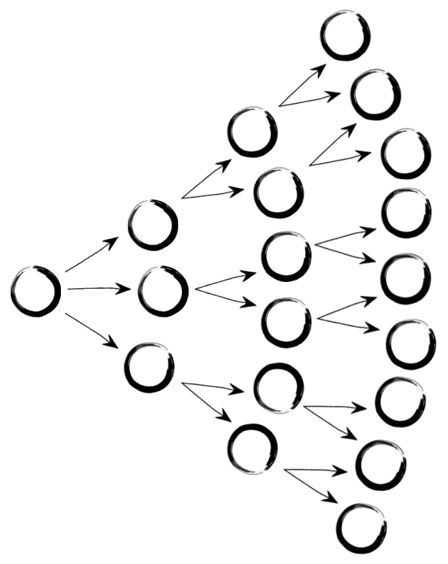
Stage 2: Mapping Narrative Structure
2. Branching Narrative
Branching storylines present multiple choices for the player.
The player is repeatedly given choices that lead to multiple new choices creating recursive narrative structures.

Slide 42
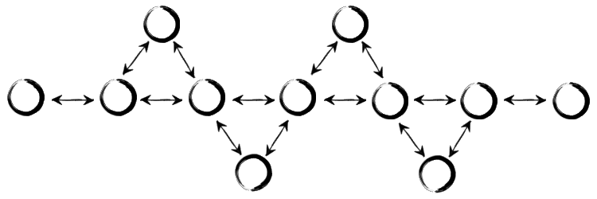
Stage 2: Mapping Narrative Structure
3. Fishbone Narrative
Benefit of this structure: story coherence preserved (Prosser, 2014)

Slide 43
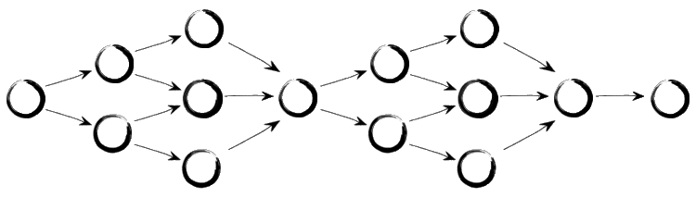
Stage 2: Mapping Narrative Structure
4. Parallel Narrative

Slide 44
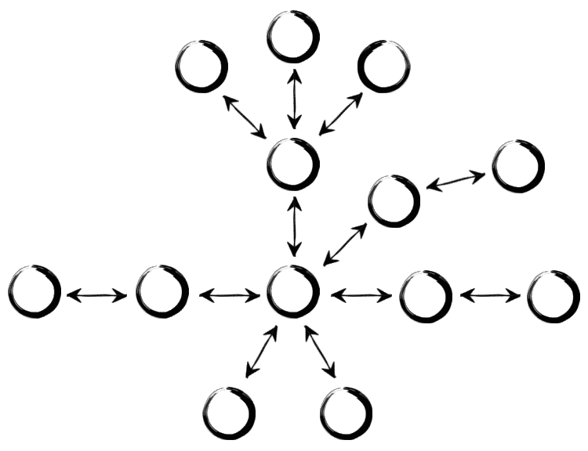
Stage 2: Mapping Narrative Structure
5. Concentric Narrative

Slide 45
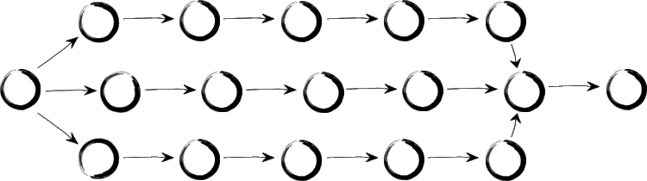
Stage 2: Mapping Narrative Structure
6. Threaded Narrative

Slide 46
Getting Started
https://github.com/sdanilovic/Twine-resources-
www.twinery.org

